Slide 1
Principles of Management
TRM 134

Slide 2
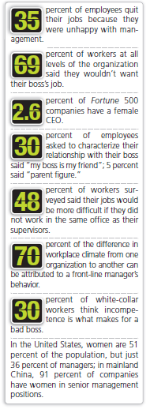
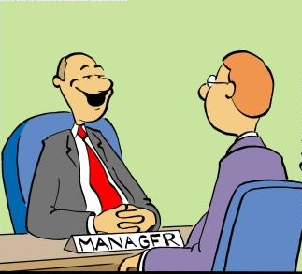
Why Study
Management?
All of us have a vested interest in improving the way organizations are managed.
Organizations that are well managed find ways to prosper even in challenging economic times.
After graduation most students become managers or are managed.
1-<number>
Notes:
Let’s look at some of the reasons why you may want to understand more about management. Because we interact with others every day of our lives, an understanding of management offers insights into many organizational aspects. Many once thriving organizations no longer exist. You can distinguish between by good and poor management by studying management.

Slide 3
What Factors Are Reshaping and Redefining Management?
Welcome to the new world of management! Today managers must deal with
  Changing workplaces
  Ethical and trust issues
  Global economic uncertainties
  Changing technologies
  Demanding (more than ever) customers
Copyright ©2011 Pearson Education
1-<number>

Slide 4
This course is designed to
give a solid understanding of the role and functions of a effective manager,
explain the principles, concepts, and techniques used by managers in carrying out their work,
give a general framework for understanding management that applies to managers in all organizations irrespective it being large or small, product- or service-oriented.

Slide 5
What is management?
Organized endeavors directed by people responsible for planning, organizing, leading and controlling have existed for thousands of years.
Because of the changing nature of organizations from mechanistic (simple or bureaucratic) to more organic organizations with flatter structures, the approach to management is altered to one of coaching rather than directing.

Slide 6
From the Past to the Present
The specific use of the word “management" as “one who conducts a house of business or public institution” is said to have originated in 1705, according to some sources.
First record of the word “manager” as a noun by Shakespeare «Love's Labour's Lost» (1598)
Other sources say that the origin is from the word “maneggiare”, which meant “to handle, direct or train horses,” and was a derivative of the Latin word for hand, “manus” (1550s).

Slide 7

When did management start?
Undeniable proofs of early management
  Göbekli Tepe (dated to c. 9000 BC)
  The Egyptian Pyramids (3000-2500 BC)
  The Great Wall of China (500 BC)
  Materials were loaded to the warships in Venice channels quite similar to assembly lines (1400s)
    the accounting system was developed by the Italians to keep track of revenues and costs
Copyright ©2011 Pearson Education
1-<number>

Slide 8
Current Management Thought’s Roots
Copyright ©2011 Pearson Education
1-<number>

Slide 9
Historical Background
Adam Smith
  Published The Wealth of Nations in 1776
    Advocated the division of labor (job specialization) to increase the productivity of workers
Industrial Revolution
  Substituted machine power for human labor
  Created large organizations which engaged in mass production and needed management structures.

Slide 10
Management Perspectives Over Time
2000
The Technology-Driven Workplace
1990
2012
The Learning Organization
1970
2010
Total Quality Management
2000
1960
Contingency Views
1950
2000
Systems Theory
1940
2000
Management Science Perspective
1930
1990
Humanistic Perspective
1890
1990
Classical
1940
1870
2010

Slide 11
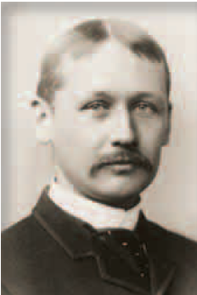
Classical Approaches
The words ‘management’ and manager are more appropriate to the early twentieth century. The words were first popularized by F.W. Taylor with his book “Principles of Scientific Management” (1911), which was widely embraced by managers around the world.
The book described the use of scientific methods to define the “one best way” for a job to be done. Some of these techniques like the analysis of basic work, and time-and-motion studies are still used today.
Copyright ©2011 Pearson Education
1-<number>

Slide 12
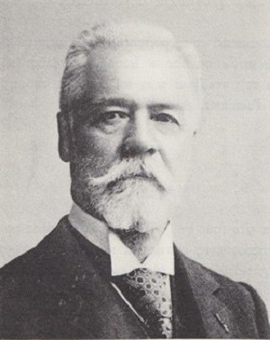
The General Administrative Theory
Developed by Max Weber and Henry Fayol around 1920s by focusing on what managers do and what constituted good or ‘rational’ management.
‘planning, organizing, coordinating, commanding and controlling of human and other resources to achieve organizational goals effectively and efficiently’
Fayol was born in 1841 in a suburb of Istanbul, Ottoman Empire. His father (an engineer) was appointed superintendent of works to build the Galata Bridge (Wikipedia).

Slide 13
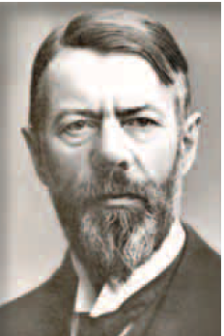
Other Classic Approaches
General Administrative Theory
  focused on what constituted good management
  Max Weber described the bureaucracy as an ideal rational form of organization
  Henri Fayol identified 5 management functions and 14 management principles
Copyright ©2011 Pearson Education

Slide 14
Henri Fayol 1841-1925
Division of labor
Authority
Discipline
Unity of command
Unity of direction
Subordination of individual interest
Remuneration
Centralization
Scalar chain
Order
Equity
Stability and tenure of staff
Initiative
Esprit de corps

Slide 15

Bureaucratic Organizations
Division of labor
with clear definitions of
authority and responsibility
Positions organized
in a hierarchy of authority
Personnel are
selected and promoted based
on technical qualifications
Managers subject to
rules and procedures
that will ensure reliable
behavior
Administrative acts
and decisions recorded
in writing
Management separate
from the ownership
of the organization

Slide 16
Behavioral Approaches
Early management writers included
  Robert Owen, was concerned about deplorable working conditions
  Hugo Munsterberg, a pioneer the field of industrial psychology
  Mary Parker Follett recognized hat organizations could be viewed from both individual and group behavior.
Copyright ©2011 Pearson Education

Slide 17
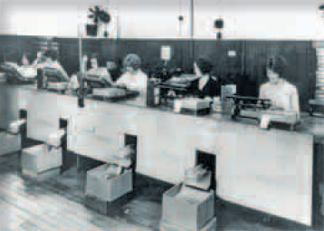
The Hawthorne Studies
Conducted (1924-1932) at the Western Electric Company Works these studies:
  Provided new insights into individual and group behavior
  in the behavior of people at work.
  Concluded that group pressures can significantly impact individual productivity
Copyright ©2011 Pearson Education
1-<number>

Slide 18
Quantitative Approaches
Quantitative techniques used to improve decision making
  Evolved from mathematical and statistical solutions developed for military problems during World War II
  Edwards Deming and Joseph M. Duran ‘s ideas became the basis for total quality management (TQM) or a total commitment to:
      High-quality results.
      Continuous improvement.
      Customer satisfaction.
    Meeting customers’ needs.
    Doing all tasks right the first time.
    Continuous improvement focuses on two questions:
      Is it necessary?
      If so, can it be done better?
Copyright ©2011 Pearson Education
1–<number>

Slide 19
1
Chapter
Managers
and
Management
Copyright ©2011 Pearson Education

Slide 20
Who Are Managers?
Where Do They Work?
Managers work in/for organizations to achieve high performance
Organization
  A deliberate arrangement of people brought together to accomplish a specific purpose.
  our university, your neighborhood convenience store, a professional basketball team, international chain hotels, multinational companies..
1-<number>

Slide 21
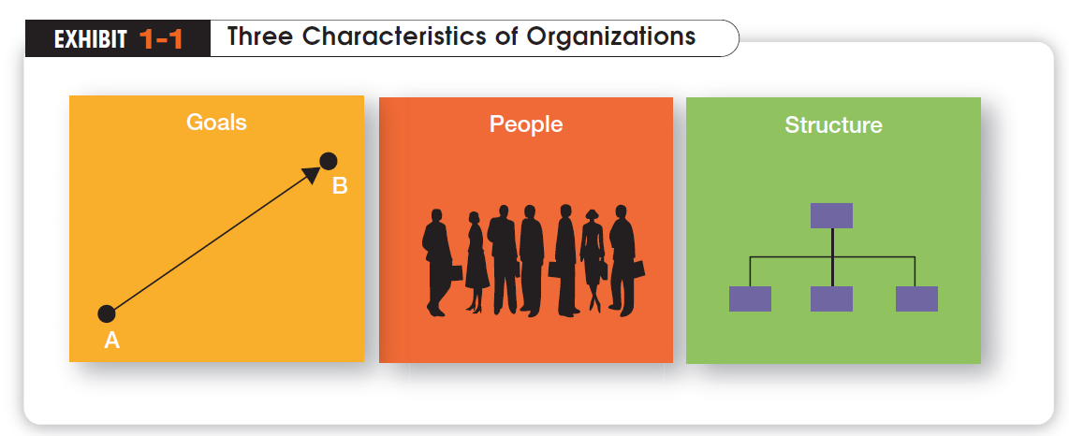
  Distinct purpose
  People working together
  A deliberate systematic structure

Slide 22
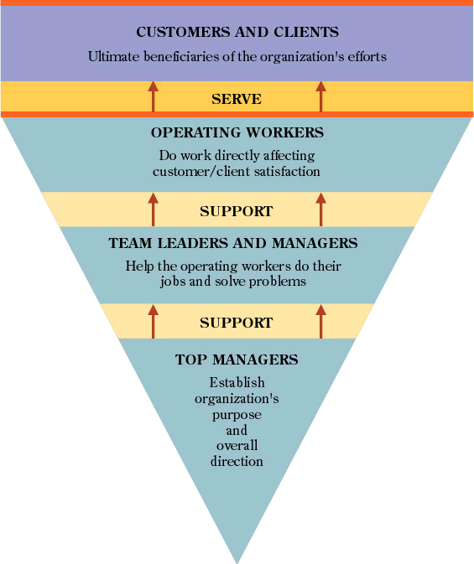
What is a high-performance organization?
Organizational Behavior: Chapter 2

Slide 23
How Are Managers Different from Non-managerial Employees?
Non-managerial Employees
  People who work directly on a job or task and have no responsibility for overseeing the work of others.
  Examples, associates, team members
Managers
  direct the activities of others.
  oversee the work of others.
1-<number>
Notes:
For simplicities sake, we can divide organization members into two categories: nonmanagerial employees and managers. Nonmanagerial employees do not oversee the work of others. Managers direct and oversee the activity of the people in the organization.

Slide 24
What Is Management?
Management
  The process of getting things done effectively and efficiently, with and through people
Effectiveness
  “Doing the right things”, doing those tasks that help an organization reach its goals
Efficiency
  Concerned with the means, efficient use of resources like people, money, and equipment
Notes:
Management is a process of getting things done, effectively and efficiently, with through people. A process is a set of ongoing and interrelated activities. In our definition it refers to the primary activities or functions managers perform.

Slide 25
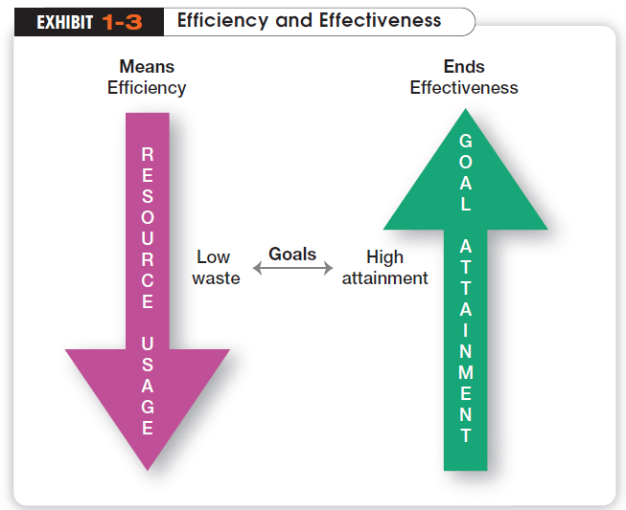

Slide 26

What Do Managers Do?
In the functions approach proposed by French industrialist Henri Fayol, all managers perform certain activities or functions
Notes:
Henri Fayol, a French industrialist in the early twentieth century, proposed that all managers perform five management activities: plan, organize, command, coordinate and control. Today these management functions have been condensed to four.

Slide 27
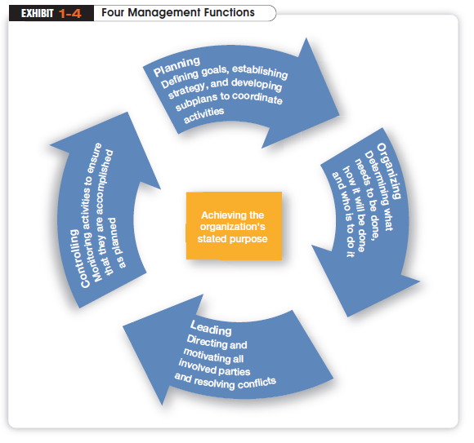

Slide 28
What Roles Do Managers Play?
Henry Mintzberg observed that a manager’s job can be described by 10 roles performed by managers in three general categories
Interpersonal Roles
  Figurehead, Leader, and Liaison
Informational Roles
  Monitor, Disseminator and Spokesperson
Decisional roles
  Entrepreneur, Disturbance Handler, Resource Allocator and Negotiator
Notes:
In the late 1960s, Henry Mintzberg did an empirical study of chief executives and discovered that managers were engaged in a number of varied, un-patterned, and short-duration activities. He defined management by categorizing what managers do based on the managerial roles they perform at work.

Slide 29
What Skills Do Managers Need?
Robert Katz and others describe 4 critical skills in managing
Conceptual Skills
  Used to analyze complex situations
Interpersonal Skills
  Used to communicate, motivate, mentor and delegate
Technical Skills
  Based on specialized knowledge required for work
Political Skills
  Used to build a power base and establish connections
Notes:
Another way to describing what managers do is by looking at the skills they need in managing. Managers must possess four critical skills in managing. Conceptual skills, Interpersonal Skills, Technical Skills and Political Skills.

Slide 30
What Titles Do Managers Have?
Top Managers
  Responsible for making decisions about the direction of the organization.
  Examples: President, Chief Executive Officer, Vice-President
Middle Managers
  Manage the activities of other managers.
  Examples: District Manager, Division Manager
First-line Managers
  Responsible for directing non-managerial employees
  Examples: Supervisor, Team Leader
Notes:
Managers are usually classified as top, middle or first-line. But be aware that they can have a variety of titles.

Slide 31
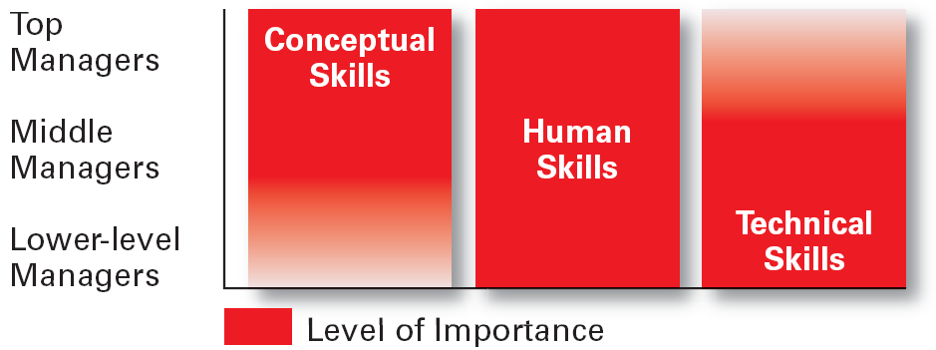
Skills Needed at Different Levels

Slide 32
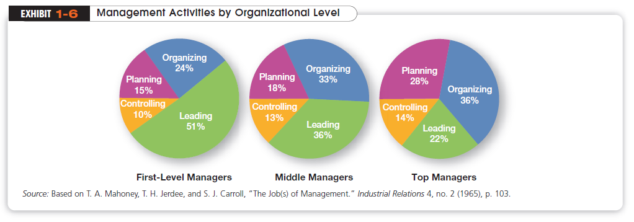
Copyright ©2011 Pearson Education
1-<number>

Slide 33
Is The Manager’s Job Universal?
The previous discussion describe management as a generic activity. In reality, a manager’s job varies with along several dimensions
Level in the Organization
  Top level managers do more planning than supervisors
Profit vs. Nonprofit
  Management performance is measured on different objectives
Copyright ©2011 Pearson Education
1-<number>
Notes:
While the importance of managerial roles varies depending on a manager’s position within an organization, the differences are of degree and emphasis, not of function. As managers move up the organization, for example, they spend less time supervising and more time planning.
All managers, however, make decisions and plan, lead, organize, and control. But the amount of time they give to each activity is not necessarily constant. In addition, the content of the managerial activities changes with the manager’s level.
When measuring managerial performance in business, profit (the bottom line) is an unambiguous criterion. Even though not-for-profit organizations need money to survive, however, their managers do not live and die to maximize profits.
Given this difference, managers working in profit and not-for-profit organizations must perform similar functions: planning, organizing, leading, and controlling.

Slide 34
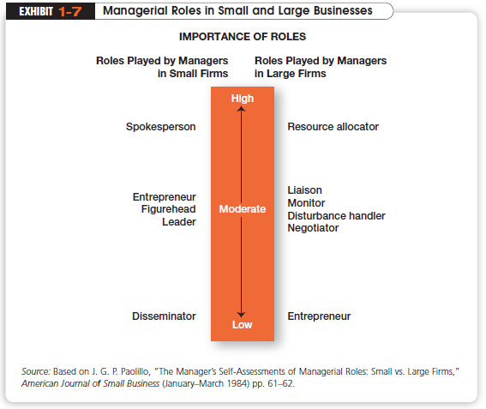
Is the Manager’s Job Universal? (cont’d)
Size of the Organization
  Small businesses require an emphasis in the management role of spokesperson
Copyright ©2011 Pearson Education
1-<number>

Slide 35

Is the Manager’s Job Universal? (cont’d)
National Borders
  Most of these concepts work best in English-speaking countries and may need to be modified in other global environments
Copyright ©2011 Pearson Education
1-<number>

